Slide 1

LCM Webinar Series
3.0 Working with Article Transfer Service (ATS): a practical guide for editors
Edit Master text styles
Thank you for joining us today
November 2021
Presented by the Learning and Content Management (LCM) Team

Slide 2
3.0 Working with Article Transfer Service (ATS): a practical guide for editors
Agenda
What is Article Transfer Service (ATS) and why is it an important tool?
What ATS workflows are possible in Editorial Manager and how do they work?
What is the ATS experience for editors in both feeder and receiver journals, as well as authors?
Notes:
Our agenda today asks these three main questions:
What is Article Transfer Service (ATS) and why is it an important tool?
What ATS workflows are possible in Editorial Manager and how do they work?
What is the ATS experience for editors in both feeder and receiver journals, as well as authors?
You’ll notice that we use the abbreviation ATS to mean Article Transfer Service throughout our session today.

Slide 3
3.0 Working with Article Transfer Service (ATS): a practical guide for editors
What is ATS?
Article Transfer Service (ATS) is the process of rejecting an article from one journal and facilitating the submission to a more suitable journal within Elsevier.
Journal A – Paper is rejected
Journal B – Paper is submitted
Feeder journal
Receiver journal
Notes:
ATS is the process of rejecting an article from one journal, using a specific type of 'transfer' decision term, and facilitating the submission to an alternative journal.
[Click 1] The journal rejecting the paper is the 'feeder' journal
[Click 2] The journal the paper is transferred to is the ‘receiver’ journal and there must be a pre-established connection between these journals for the transfer to take place.
This illustration on screen shows us ATS in it’s most simplistic form, and we will look at a more detailed example shortly.

Slide 4

Benefits of ATS
3.0 Working with Article Transfer Service (ATS): a practical guide for editors
Why is it important for you as Editor to actively participate in the transfer process?
  Transfers are easy and no extra work is required from you.
  You have assessed the manuscript already, and that knowledge can be used to help the author get published in another journal.
  It helps with retention rate:
    Metrics show a larger portion of rejects from Elsevier journals are high quality and go on to be published in competitive titles
    Multiple journals engaged in ATS have been able to help over 10% of rejected authors to publication
We’ve received positive feedback from authors, such as:
​“I like the idea very much, the service would make my life easier.”
​“It gives you the idea that they care about your paper and they care about you.” ​
Notes:
What are the benefits of ATS and why is it important to you as an editor to participate?
Transfers are easy and no extra work is required from you.
You have assessed the manuscript already, and that knowledge can be used to help the author get published in another journal.
It helps with retention rate:
Metrics show a larger portion of rejects from Elsevier journals are high quality and go on to be published in competitive titles
Multiple journals engaged in ATS have been able to help over 10% of rejected authors to publication
We’ve also received positive feedback from authors.

Slide 5

ATS connections in Editorial Manager
3.0 Working with Article Transfer Service (ATS): a practical guide for editors
Unidirectional
Bidirectional
Journal A
Journal B
Journal A
Journal B
Notes:
Let’s look in more detail at how ATS works between journals and the possible workflows available.
ATS connections between feeder and receiver journals in EM must be established in order for transfers to happen, and these can be set up in two ways.
[Click 1] Some journals are feeder-only, some are receiver-only – this is a unidirectional connection
[Click 2] Some journals are both feeder and receiver journals – these are bidirectional connections
[Click 3] For example, if Journal A is connected to feed Journal B only, this is a unidirectional connection.
[Click 4] If journal A feeds journal B and journal B feeds journal A as well, the connection is bidirectional.
And we apply these terms when there are more than two journals making a connection.

Slide 6





3.0 Working with Article Transfer Service (ATS): a practical guide for editors
ATS workflow
Though multiple workflows are available, the ATS process comprises the following steps:
Editor of Journal A decides to reject paper using a ‘transfer’ decision term
Paper is rejected from Journal A with offer of transfer to Journal B or Journal C
Author completes the submission of the paper to Journal B
Author accepts the transfer offer to Journal B
Paper is accepted for publication in Journal B
Guidance is that transfer offers should be made to approximately 60% of rejected manuscripts
Notes:
We are now going to look at some more details of an ATS workflow in EM.
In this illustration we can see how ATS might work in a real life example. You can see that there is more than one receiver journal possible. Journal A is rejecting a paper and offering a transfer to journal B or C.
If the author agrees with the transfer, the submission files are transferred over to the Receiver Journal. Reviewer comments will be transferred with the submission.
Note that submission to one of the suggested journals does not guarantee publication.
This is one example – depending on the connections of the journal, there are multiple workflows available and we would ask editors to check with their publisher about specific workflows that are available to their journal.
As an indication of how frequently an ATS offer should be made; our standard guidance is that transfer offers should be made to approximately 60% of rejected manuscripts – but again, this is individual to the journal and Editors should check with their publisher for further guidance.

Slide 7
Common ATS Workflows
3.0 Working with Article Transfer Service (ATS): a practical guide for editors
Feeder journal Editor rejects paper using a transfer decision term
Author is sent offer to transfer to selected receiver journals
Editor selects
receiver journals
Editors’ Choice
Authors’ Choice
Feeder journal Editor rejects the paper using a transfer decision term
Author is sent offer to transfer to ALL receiver journals and makes their own selection
Notes:
When the transfer offer is made, there are several options for the feeder journal and in this illustration you can see two of the most common workflow options available to feeder journals.
Editors’ Choice [also called Editor Driven] is where an Editor of a feeder journal uses a “Reject & Transfer” decision type, and will then be presented with the list of receiver journals to which their journal is connected. The Editor selects one or more appropriate receiver journals, from which the author will then be able to choose one (or none). Most journals follow this workflow.
Authors’ Choice [also called Author Driven] is where the Editor of a feeder journal uses a “Reject & Transfer” decision type, but will NOT be presented with a list of available receiver journals. Instead, the Author will be offered a transfer option to ALL of the journals to which the feeder journal is connected and will be able to make their selection.

Slide 8
Common ATS Decision Terms
3.0 Working with Article Transfer Service (ATS): a practical guide for editors
Transfer Pre-Review Reject and transfer decision is made pre-review (ie, a “desk reject”).
Transfer Post-Review Reject and transfer decision is made post-review (ie, a “standard reject”).
Transfer Recommended Accept Reject and transfer decision made post-review that is used to guarantee acceptance in the receiver journal. Feeder Editors may specify conditions of acceptance (ie, revisions) in the decision letter.
Transfer Guaranteed Review* Reject and transfer decision made pre-review that is used to guarantee peer review in the receiver journal.
*If Editors are interested, they should flag to their Publishers, who can advise on what might be possible.
Notes:
When a paper is rejected from the feeder journal, the editor must use a decision type that will enable the transfer of the submission to a receiver journal.
We can see here the most common decision types in this category.
[Click 1] Transfer Pre-Review is used to reject an article before a review has taken place, similar to a “desk reject”.
[Click 2] Transfer Post-Review is used to reject an article after a review has taken place, similar to a “standard reject”.
[Click 3] Transfer Recommended Accept is a special type of transfer, post-review, that is used to guarantee acceptance in the receiver journal. Feeder Editors may specify conditions of acceptance (for example, revisions that are needed) in the decision letter.
This decision term should only be enabled when a relationship between the feeder and receiver journal has been established such that the receiver Editors have agreed to honor such a decision, and the feeder Editors fully understand the acceptance criteria of the receiver journal.
[Click 4] Transfer Guaranteed Review. This is a special type of Transfer Pre-Review that is used to guarantee peer review in the receiver journal. This decision term should only be enabled when a relationship between the feeder and receiver journal has been established such that the receiver Editors have agreed to honor such a decision. If Editors are interested in enabling this decision term, they should flag to their Publishers, who can advise on what might be possible.

Slide 9


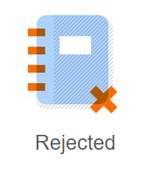
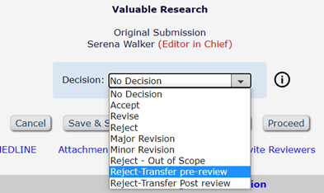
Editor experience: Feeder Journal
3.0 Working with Article Transfer Service (ATS): a practical guide for editors
Notes:
We’re now going to see how these workflows look to the editor in the feeder journal, to the author of the manuscript being transferred and to the editor in the receiver journal.
Let’s take an example of the most common workflow: Editor´s Choice.
[Click 1] Serena is the editor of the Journal A and
[Click 2] She has received a submission with the title “Valuable Research”.
[Click 3] She doesn´t think this manuscript is suitable for her journal.
[Click 4] In EM, on the decision making page, Serena selects the decision term “Transfer Pre Review” and notifies the author about her decision.

Slide 10
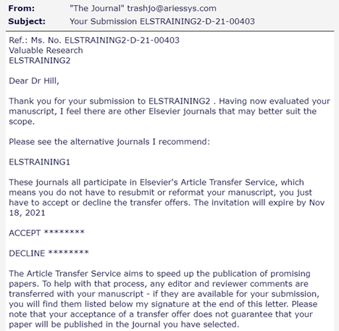
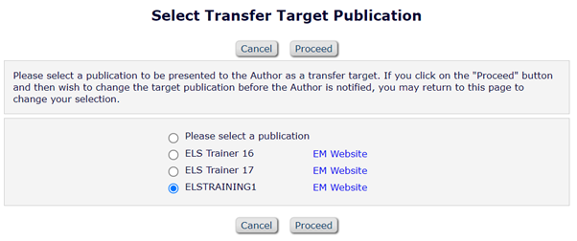
Editor Experience: Feeder Journal
3.0 Working with Article Transfer Service (ATS): a practical guide for editors
Notes:
Since this is an Editor´s Choice workflow:
[Click 1] Serena will be presented with a list of available receiver journal. She then chooses the appropriate journal or journals
[Click 2] and sends the decision letter.
[Click 3] The decision letter informs the Author that the journal participates in Elsevier´s ATS, that there’s no need to reformat or resubmit and that the transfer of their manuscript will be done for them.

Slide 11





Author's Perspective
3.0 Working with Article Transfer Service (ATS): a practical guide for editors
1. Author accepts transfer offer
2. Manuscript is automatically sent to journal B
4. Author makes any desired changes and completes the submission in Journal B
3. Author gets e-mail and logs in to EM site of Journal B
Notes:
[Click 1] Jack is the author of the manuscript “Valuable Research”. He will first receive the editor´s decision letter with a link to accept or decline the transfer offer. If he decides he wants to transfer the paper he can do it in four easy steps by clicking on the link in the email.
[Click 2] Step 1: The corresponding author will receive an email to confirm the transfer.
[Click 3] Step 2. After confirmation, the manuscript will transfer to the selected receiver journal.
[Click 4] Step 3. The receiver journal will send emails to the corresponding author asking them to sign in to their Editorial Manager site and continue with the submission.
[Click 5] Step 4. The authors can make any desired changes before approving the PDF, and they can cancel at any time.

Slide 12
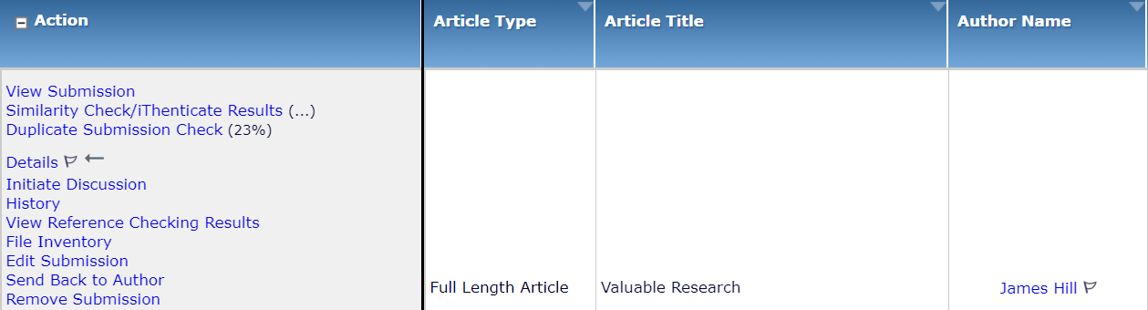

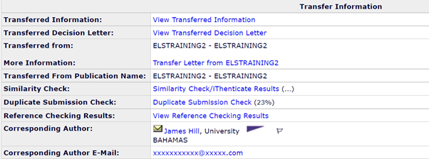
Editor Experience: Receiver Journal
3.0 Working with Article Transfer Service (ATS): a practical guide for editors
Notes:
[Click 1] Zoe is the editor of the receiver journal, journal B. She will see the paper “Valuable Research” in her New Assignment folder.
[Click 2] She will be able to identify transferred manuscripts via specific ATS flags which will show on the action list for the manuscript and
[Click 3] a special Transfer Information section in the details tab.
If transfer takes place after peer review, review reports and details are transferred along with the article. [Click 4] To view the reviewers recommendations, click on the link “View Transferred Information”

Slide 13
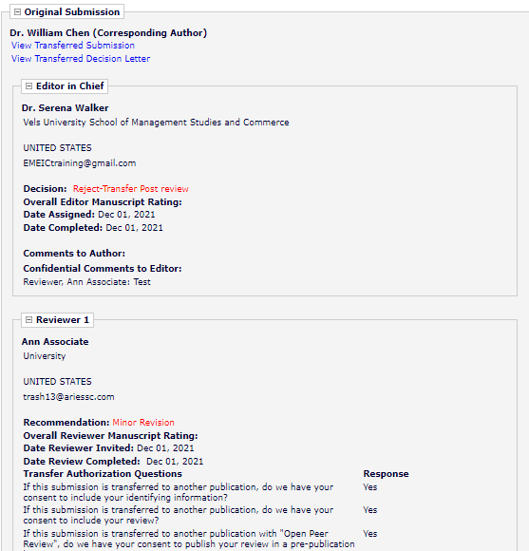
Editor Experience: Receiver Journal
3.0 Working with Article Transfer Service (ATS): a practical guide for editors
Transfer Information
Post Peer review
Notes:
[Click 1] In this illustration we can see the reviewers comments that were transferred along the submission. The reviews and/or review contact details are included for the Receiver Journal depending on the permission given by each reviewer.

Slide 14
Edit Master text styles
Thank you for joining us today.
See you next time!

